Slide 1

UNIVERSITY INSTITUTE OF ENGINEERING
COMPUTER SCIENCE ENGINEERING
Machine Learning
23CSH-651
By
Dr. Meena Pundir
INTRODUCTION
DISCOVER . LEARN . EMPOWER

Slide 2
Artificial Neural Networks : An Introduction

Slide 3
ANN
ANN posess a large number of processing elements called nodes/neurons which operate in parallel.
Neurons are connected with others by connection link.
Each link is associated with weights which contain information about the input signal.
Each neuron has an internal state of its own which is a function of the inputs that neuron receives- Activation level

Slide 4
Artificial Neural Networks
x₁
X₁
w₁
Y
y
x₂
w₂
X₂

Slide 5
Neural net of pure linear eqn.
Input
X
m
Y
mx

Slide 6
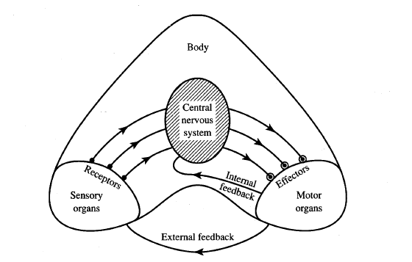
Information flow in nervous system

Slide 7
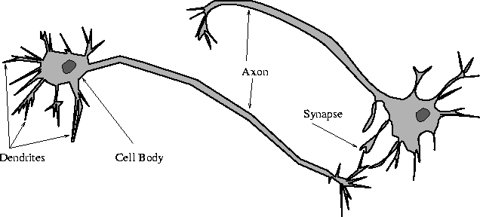
Biological Neural Network

Slide 8
Neuron and a sample of pulse train

Slide 9
Biological Neuron
Has 3 parts
Soma or cell body:- cell nucleus is located
Dendrites:- nerve connected to cell body
Axon: carries impulses of the neuron
End of axon splits into fine strands
Each strand terminates into a bulb-like organ called synapse
Electric impulses are passed between the synapse and dendrites
Synapses are of two types
Inhibitory:- impulses hinder the firing of the receiving cell
Excitatory:- impulses cause the firing of the receiving cell
Neuron fires when the total of the weights to receive impulses exceeds the threshold value during the latent summation period
After carrying a pulse an axon fiber is in a state of complete nonexcitability for a certain time called the refractory period.

Slide 10
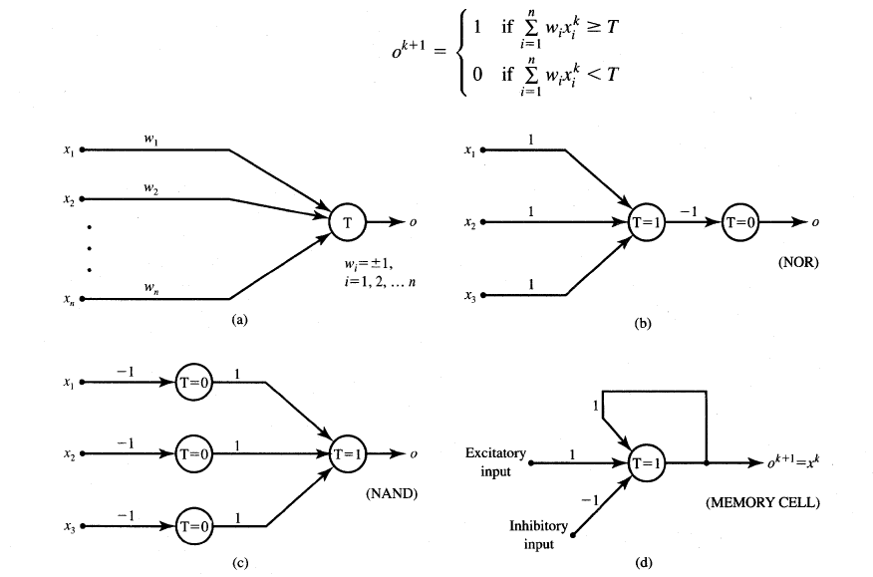
McCulloch-Pitts Neuron Model

Slide 11
Features of McCulloch-Pitts model
Allows binary 0,1 states only
Operates under a discrete-time assumption
Weights and the neurons’ thresholds are fixed in the model and no interaction among network neurons
Just a primitive model

Slide 12
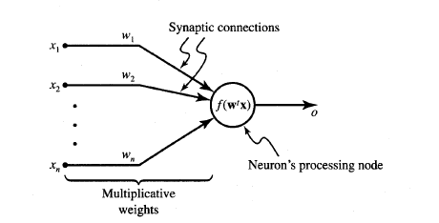
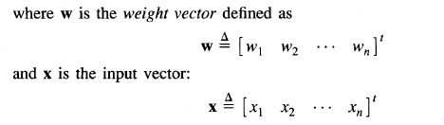
General symbol of neuron consisting of processing node and synaptic connections

Slide 13
Neuron Modeling for ANN
Is referred to activation function. Domain is set of activation values net.
Scalar product of weight and input vector
Neuron as a processing node performs the operation of summation of its weighted input.

Slide 14
Activation function
Bipolar binary and unipolar binary are called as hard limiting activation functions used in discrete neuron model
Unipolar continuous and bipolar continuous are called soft limiting activation functions are called sigmoidal characteristics.

Slide 15
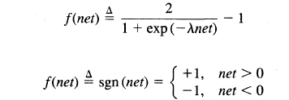
Activation functions
Bipolar continuous
Bipolar binary functions

Slide 16
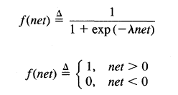
Activation functions
Unipolar continuous
Unipolar Binary

Slide 17
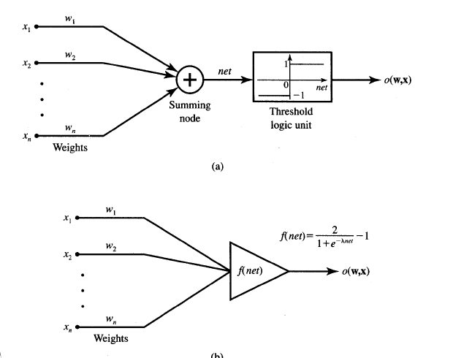
Common models of neurons
Binary perceptrons
Continuous perceptrons

Slide 18
Comparison between brain verses computer
 | Brain | ANN
Speed | Few ms. | Few nano sec. massive ||el processing
Size and complexity | 10¹¹ neurons & 10¹⁵ interconnections | Depends on designer
Storage capacity | Stores information in its interconnection or in synapse. No Loss of memory | Contiguous memory locations loss of memory may happen sometimes.
Tolerance | Has fault tolerance | No fault tolerance Inf gets disrupted when interconnections are disconnected
Control mechanism | Complicated involves chemicals in biological neuron | Simpler in ANN

